Slide 1
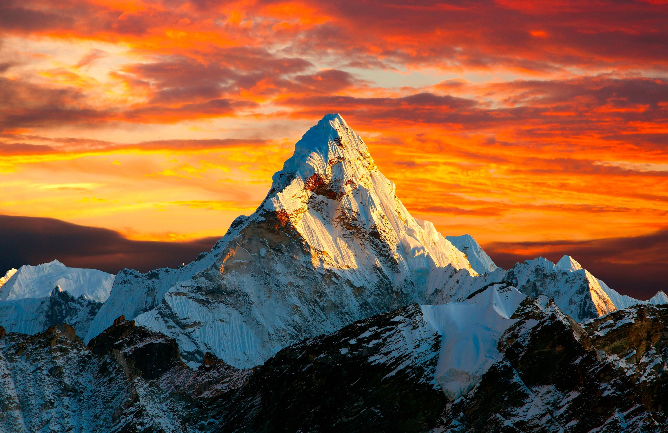
Good Good Father

Slide 2
Oh, I’ve heard
A thousand Stories
Of what they
Think you’re like

Slide 3
But I’ve heard
The tender whisper of love
In the dead of night
And you tell me
That you’re pleased
And that I’m never alone

Slide 4
You’re a good good Father
It’s who you are
And I’m loved by you
It’s who I am

Slide 5
Oh, and I’ve seen
Many searching
For answers
Far and wide

Slide 6
But I know
We’re all searching for answers
Only you provide
Cause you know just
What we need before we
Say a word

Slide 7
You’re a good good Father
It’s who you are
And I’m loved by you
It’s who I am

Slide 8
Cause you are perfect
In all of your ways
You are perfect
In all of your ways
To us

Slide 9
Oh, it’s love
So undeniable
I, I can
Hardly speak

Slide 10
Peace so
Unexplainable
I, I can
Hardly think

Slide 11
As you call me
Deeper still
Into Love
Love Love

Slide 12
You’re a good good Father
It’s who you are
And I’m loved by you
It’s who I am

Slide 13
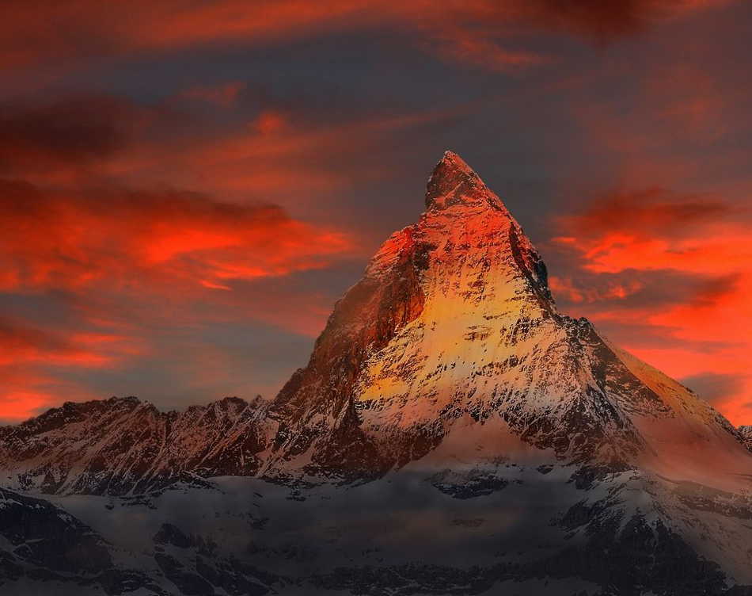
Hymn of Heaven

Slide 14
How I long to breathe the air of Heaven
Where pain is gone
and mercy fills the streets

Slide 15
To look upon the one who bled to save me
And walk with Him for all eternity

Slide 16
There will be a day
When all will bow before Him
There will be a day
When death will be no more

Slide 17
Standing face to face
With He who died and rose again
Holy holy is the Lord

Slide 18
Every prayer we prayed in desperation
The songs of faith
We sang through doubt and fear

Slide 19
In the end we’ll see that it was worth it
When He returns to
wipe away our tears

Slide 20
There will be a day
When all will bow before Him
There will be a day
When death will be no more

Slide 21
Standing face to face
With He who died and rose again
Holy holy is the Lord

Slide 22
On that day we join the resurrection
And stand beside the heroes of the faith

Slide 23
With one voice a thousand generations
Sing worthy is the Lamb who was slain

Slide 24
On that day we join the resurrection
And stand beside the heroes of the faith

Slide 25
With one voice a thousand generations
Sing worthy is the Lamb who was slain
Forever He shall reign

Slide 26
So let it be today
We shout the hymn of Heaven
With angels and the Saints
We raise a mighty roar

Slide 27
Glory to our God
Who gave us life beyond the grave
Holy holy is the Lord

Slide 28
So let it be today
We shout the hymn of Heaven
With angels and the Saints
We raise a mighty roar

Slide 29
Glory to our God
Who gave us life beyond the grave
Holy holy is the Lord
Holy holy is the Lord
Holy holy is the Lord

Slide 30
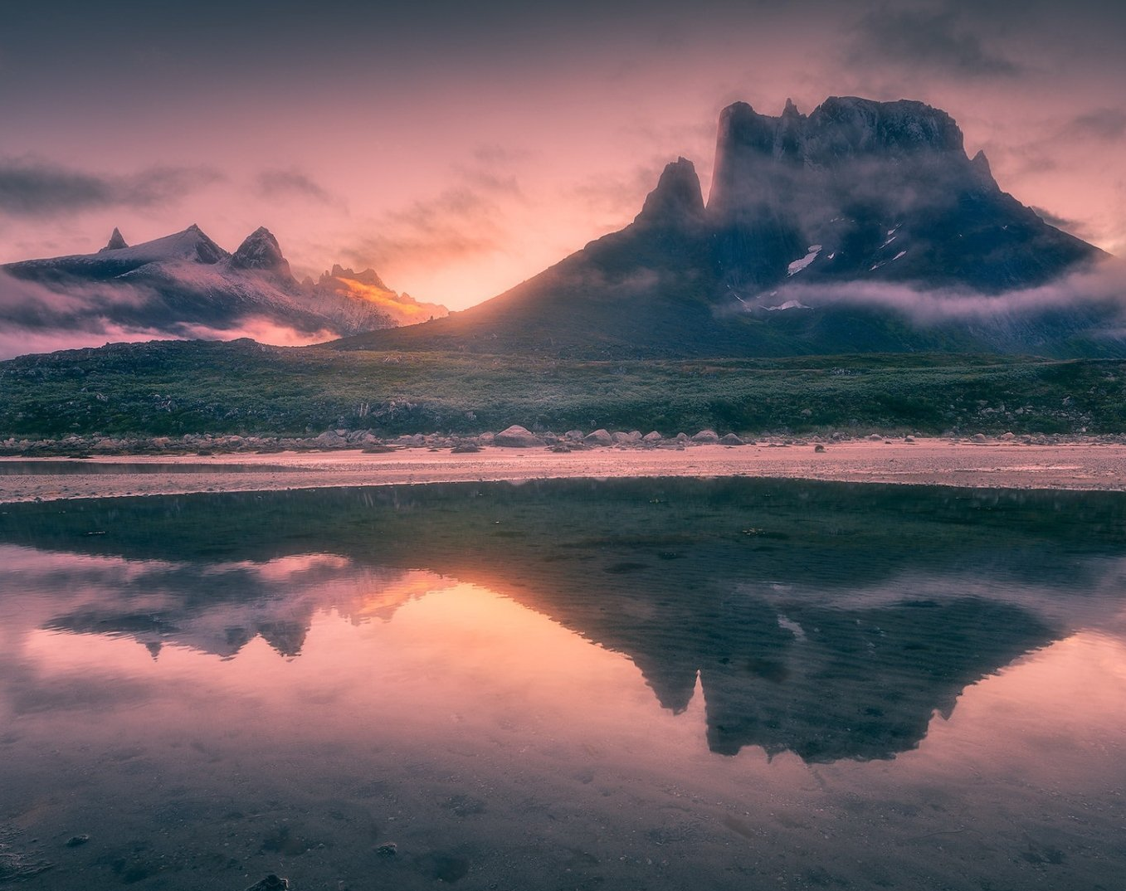
His Mercy is More

Slide 31
Praise the Lord,
His mercy is more
Stronger than darkness,
new every morn

Slide 32
Our sins they are many,
His mercy is more

Slide 33
What love could remember,
no wrongs we have done
Omniscient all-knowing,
He counts not their sum

Slide 34
Thrown into a sea,
without bottom or shore
Our sins they are many,
His mercy is more

Slide 35
Praise the Lord,
His mercy is more
Stronger than darkness,
new every morn

Slide 36
Our sins they are many,
His mercy is more

Slide 37
What patience would wait as we
constantly roam
What Father so tender
is calling us home

Slide 38
He welcomes the weakest,
the vilest, the poor
Our sins they are many,
His mercy is more

Slide 39
Praise the Lord,
His mercy is more
Stronger than darkness,
new every morn

Slide 40
Our sins they are many,
His mercy is more

Slide 41
What riches of kindness
He lavished on us
His blood was the payment,
His life was the cost

Slide 42
We stood 'neath a debt
we could never afford
Our sins they are many,
His mercy is more

Slide 43
Praise the Lord,
His mercy is more
Stronger than darkness,
new every morn

Slide 44
Our sins they are many,
His mercy is more
Our sins they are many,
His mercy is more

